Slide 1
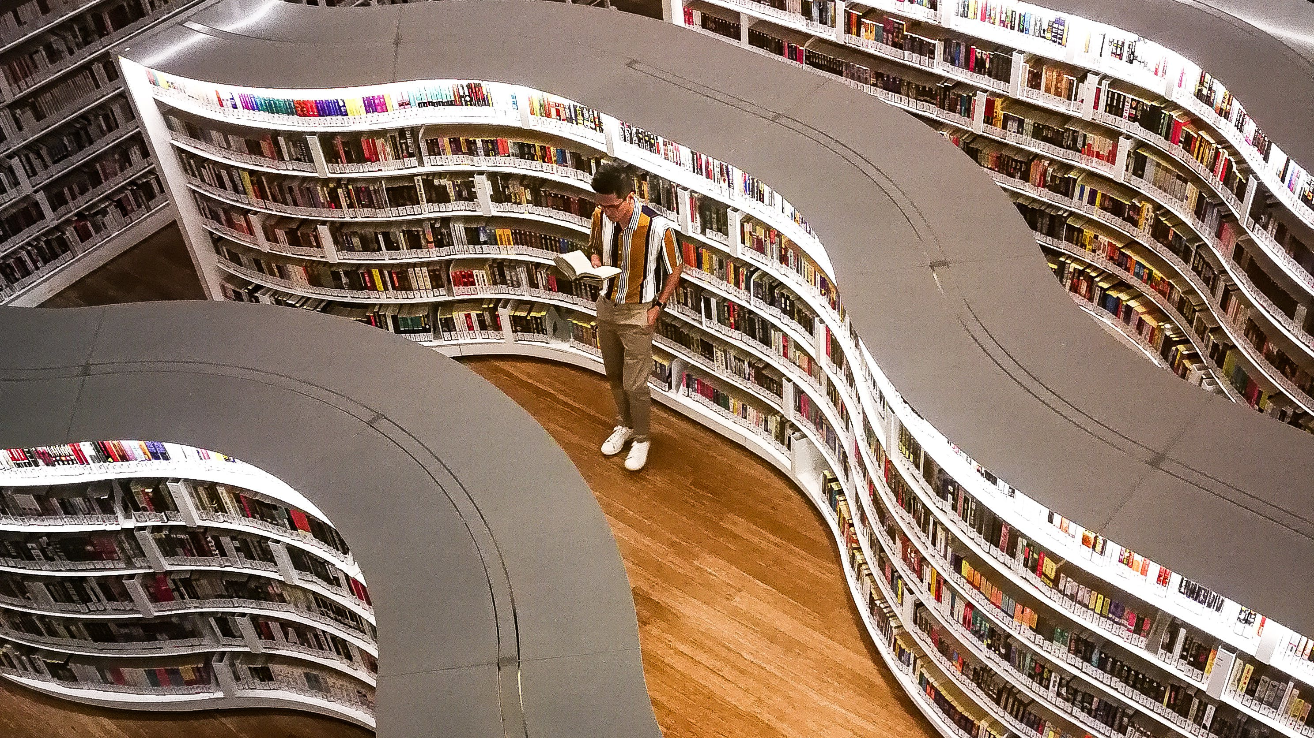
Library Management System

Slide 2
Introduction:
Welcome to the Library Management System, A library management system is a comprehensive software solution designed to facilitate and automate the management of library resources, including books, journals, multimedia, and other materials. Our system is designed to streamline library operations, providing a user-friendly interface for cataloging, borrowing, and managing resources. Let's embark on a journey of seamless library administration.​

Slide 3
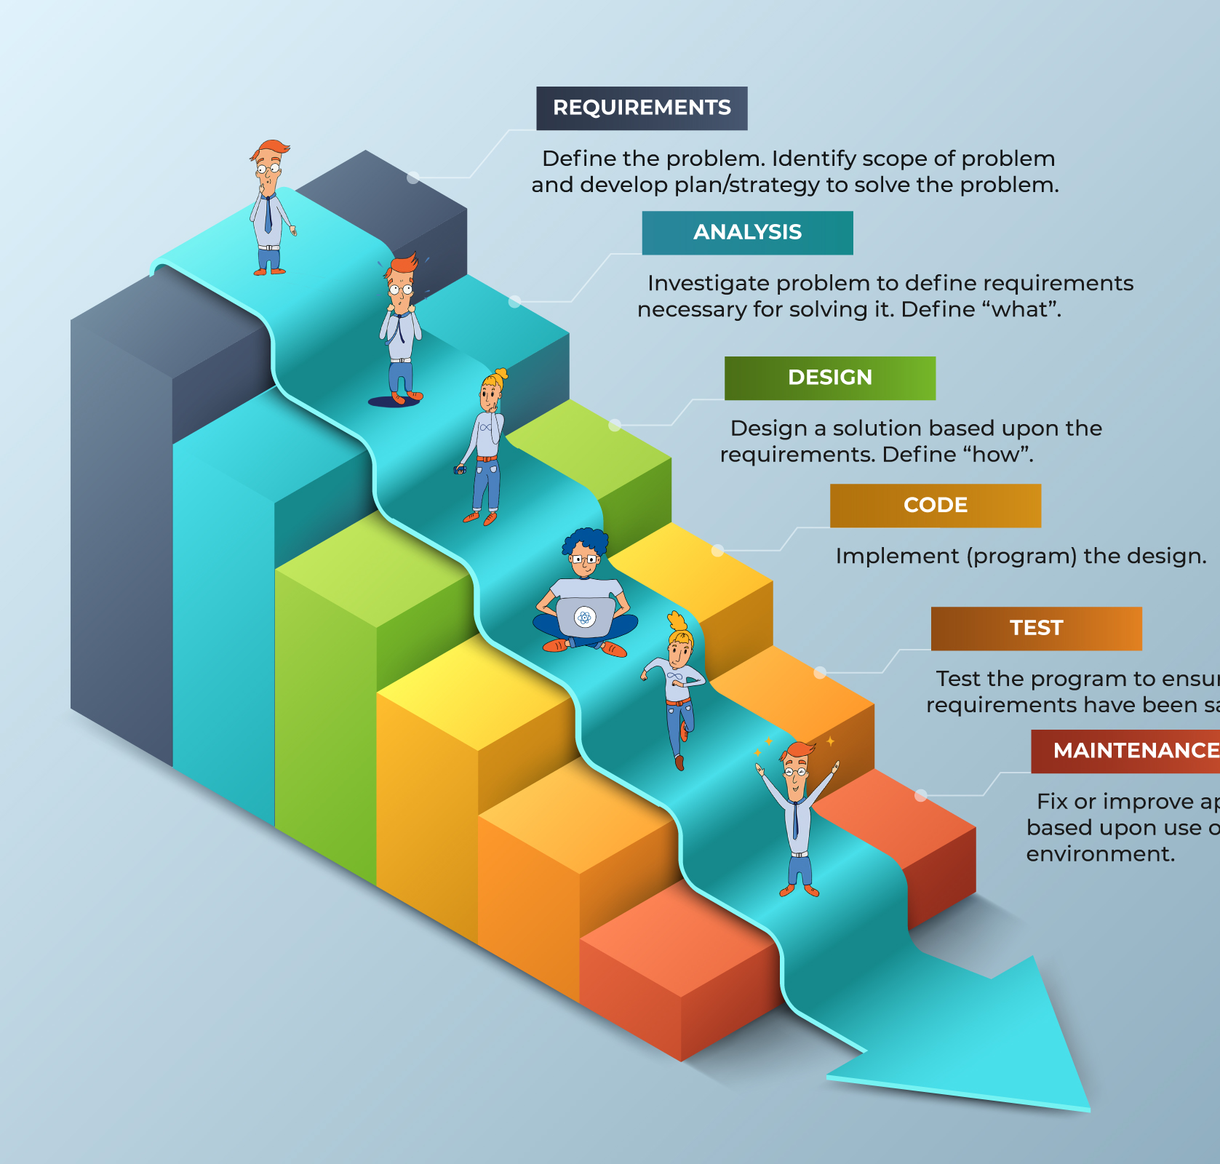
We use the waterfall model because:​ ​ .This model is used only when the requirements are very​ ​. well known, clear and fixed.​ ​.Product definition is stable.​ ​.Technology is understood.​ ​.There are no ambiguous requirements​ ​.Ample resources with required expertise are available freely​ .The project is short.​ ​

Slide 4
The Requirement:
Functional requirement:​
1:A user should be able to check out a book and return it in due time​
2:A user should be able to reserve a book for checkout.​
3:The library staff should be able to add new books to the inventory.​
4:The library staff should be able to generate reports about the library inventory.​
None functional requirement:​
1: Appearance: simple look and good feel to use ​
2:Availability:the system must be available 100% for the users​
3: Reliability requirement: the system has to be 100% reliable due the important of data​

Slide 5
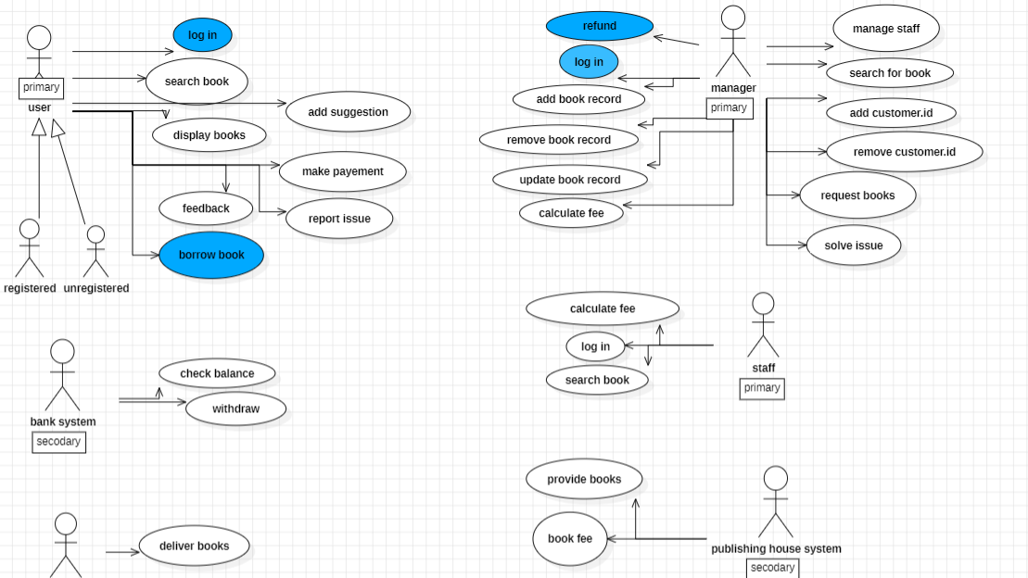

Slide 6
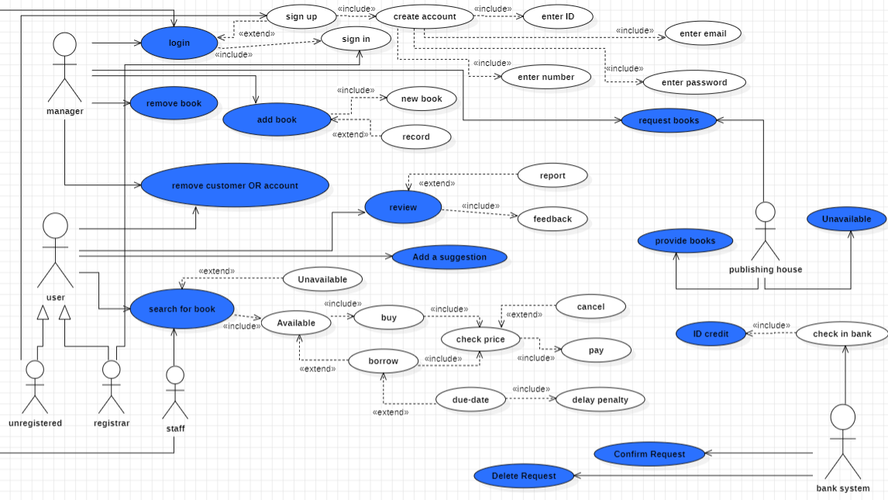

Slide 7
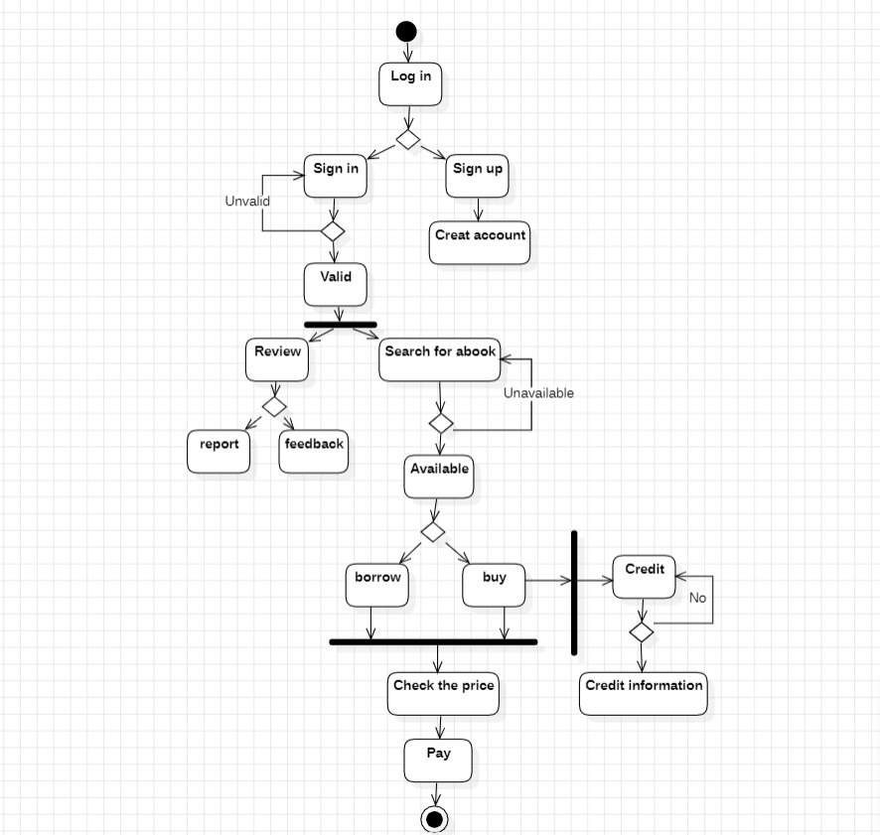

Slide 8
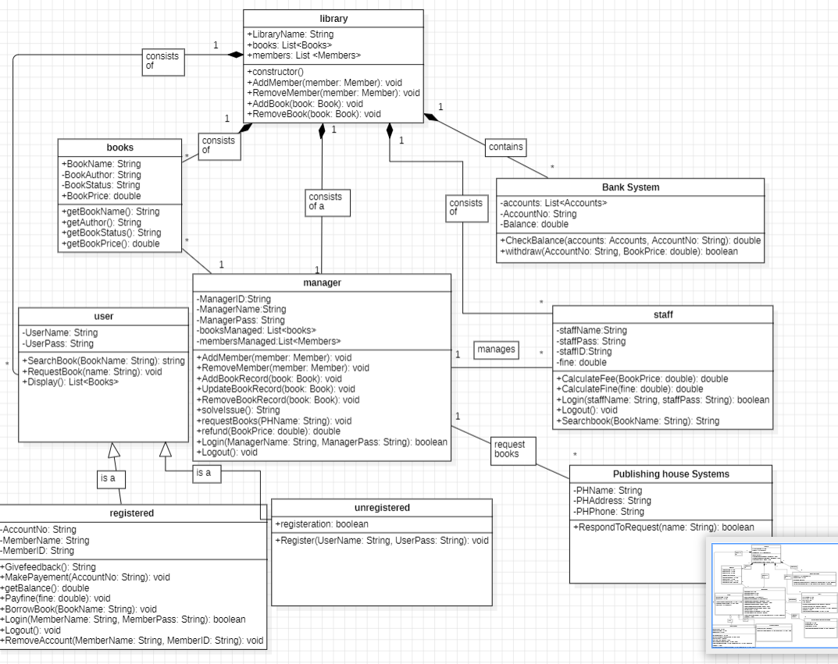

Slide 9
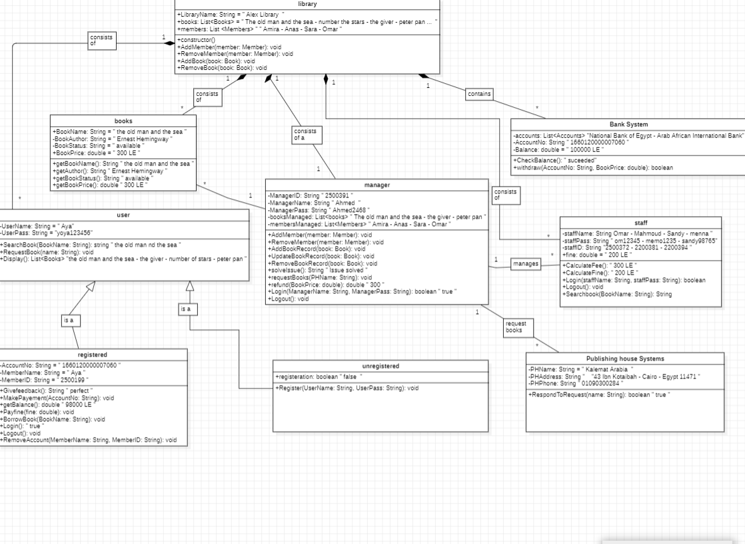

Slide 10
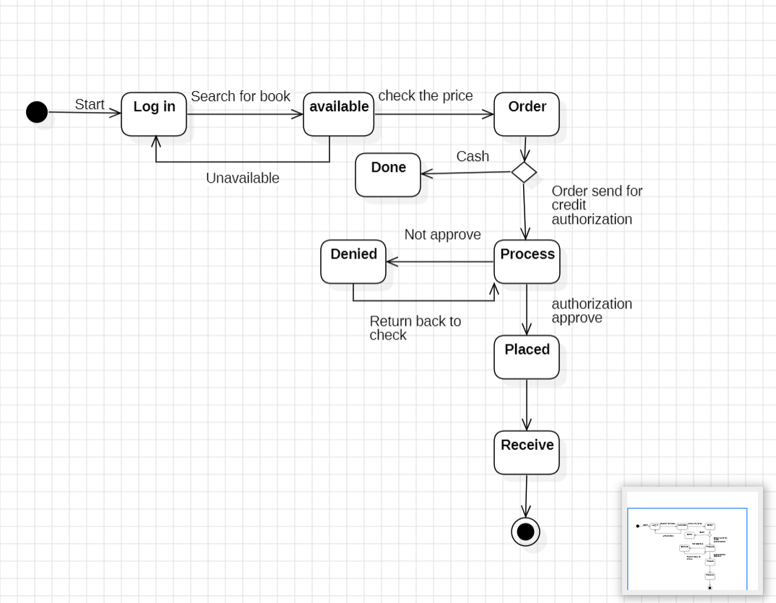

Slide 11
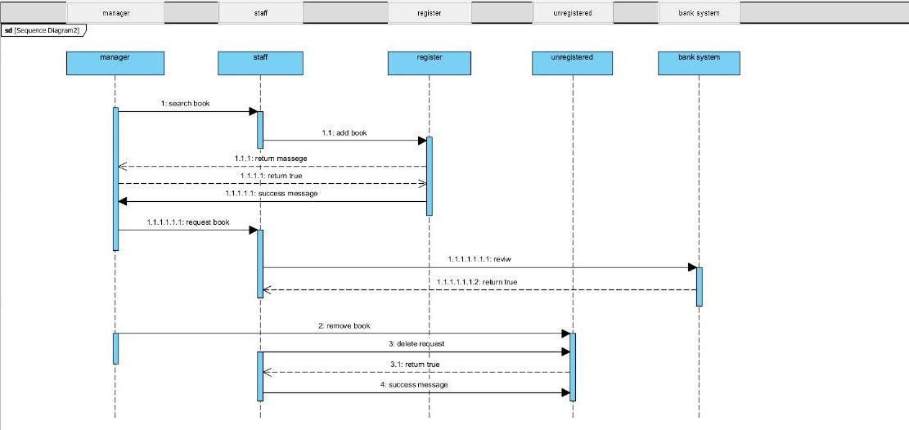

Slide 12
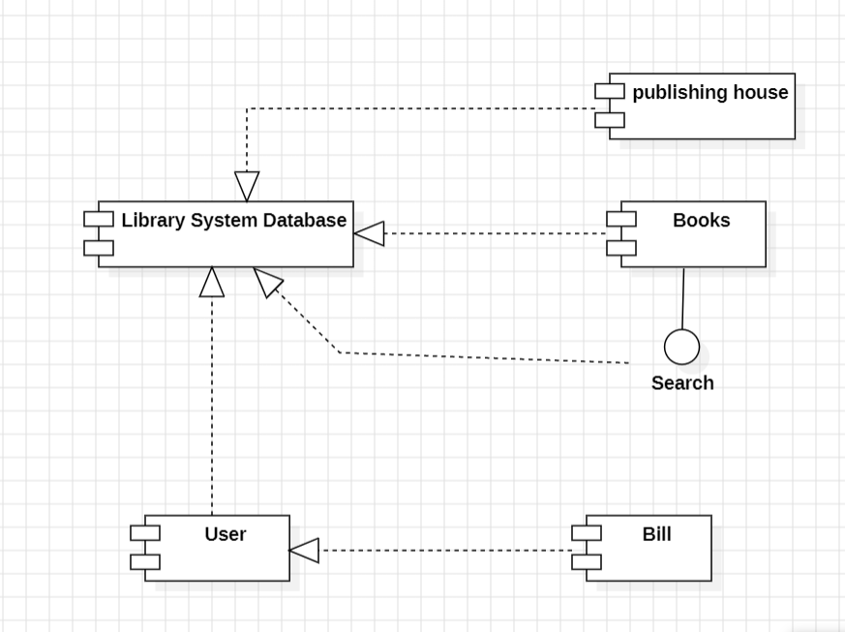

Slide 13
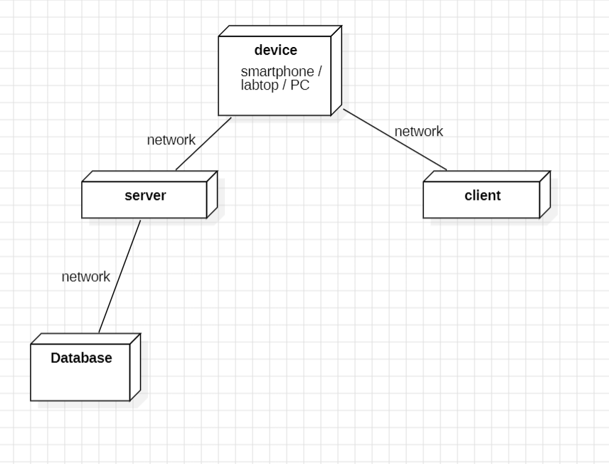

Slide 14

Made By: Razan Mohamed kamal(Activity, state chart) Yasmin Walid gamal(use case , component) Shahinaz Samy Mohamed (b.usecase , class) Hend Mofreh raslan(sequence) Aya Selim Mohamed(object , deployment)

